Slide 1
Introduction to Javascript
Daniyal Nagori

Slide 2
About Instructor
Chief Executive Officer - PIAIC
Director at Panacloud
Chief Technical Officer - TravelclubIQ

Slide 3



About Instructor
Notes:
https://www.credly.com/badges/c3e0f7e9-4c13-4393-91a8-42e9901e2e04/linked_in_profile
https://graduation.udacity.com/confirm/4epk27st
https://www.credly.com/badges/7f8f27e0-1dad-4011-8565-f648cb709829/linked_in_profile

Slide 4
History of Javascript

Slide 5
Creation At Netscape

Slide 6

Creation at Netscape
The first web browser with a graphical user interface, Mosaic, was released in 1993. Accessible to non-technical people, it played a prominent role in the rapid growth of the nascent World Wide Web. The lead developers of Mosaic then founded the Netscape corporation, which released a more polished browser, Netscape Navigator, in 1994. This quickly became the most-used.

Slide 7
Creation at Netscape
During these formative years of the Web, web pages could only be static, lacking the capability for dynamic behavior after the page was loaded in the browser. There was a desire in the flourishing web development scene to remove this limitation, so in 1995, Netscape decided to add a scripting language to Navigator. They pursued two routes to achieve this: collaborating with Sun Microsystems to embed the Java programming language, while also hiring Brendan Eich to embed the Scheme language.

Slide 8
Creation at Netscape
Netscape management soon decided that the best option was for Eich to devise a new language, with syntax similar to Java and less like Scheme or other extant scripting languages. Although the new language and its interpreter implementation were called LiveScript when first shipped as part of a Navigator beta in September 1995, the name was changed to JavaScript for the official release in December.

Slide 9
Creation at Netscape
The choice of the JavaScript name has caused confusion, implying that it is directly related to Java. At the time, the dot-com boom had begun and Java was the hot new language, so Eich considered the JavaScript name a marketing ploy by Netscape.

Slide 10
Adoption At Microsoft

Slide 11
Adoption by Microsoft
Microsoft debuted Internet Explorer in 1995, leading to a browser war with Netscape. On the JavaScript front, Microsoft reverse-engineered the Navigator interpreter to create its own, called JScript.

Slide 12
Adoption by Microsoft
JScript was first released in 1996, alongside initial support for CSS and extensions to HTML. Each of these implementations was noticeably different from their counterparts in Navigator. These differences made it difficult for developers to make their websites work well in both browsers, leading to widespread use of "best viewed in Netscape" and "best viewed in Internet Explorer" logos for several years

Slide 13
The Rise of JScript

Slide 14
The rise of JScript
In November 1996, Netscape submitted JavaScript to Ecma International, as the starting point for a standard specification that all browser vendors could conform to. This led to the official release of the first ECMAScript language specification in June 1997. The standards process continued for a few years, with the release of ECMAScript 2 in June 1998 and ECMAScript 3 in December 1999. Work on ECMAScript 4 began in 2000.

Slide 15
The rise of JScript
Meanwhile, Microsoft gained an increasingly dominant position in the browser market. By the early 2000s, Internet Explorer's market share reached 95%. This meant that JScript became the de facto standard for client-side scripting on the Web.
Microsoft initially participated in the standards process and implemented some proposals in its JScript language, but eventually it stopped collaborating on Ecma work. Thus ECMAScript 4 was mothballed.

Slide 16
Growth and standardization

Slide 17
Growth and standardization
During the period of Internet Explorer dominance in the early 2000s, client-side scripting was stagnant. This started to change in 2004, when the successor of Netscape, Mozilla, released the Firefox browser. Firefox was well received by many, taking significant market share from Internet Explorer.

Slide 18
Growth and standardization
In 2005, Mozilla joined ECMA International, and work started on the ECMAScript for XML (E4X) standard. This led to Mozilla working jointly with Macromedia (later acquired by Adobe Systems), who were implementing E4X in their ActionScript 3 language, which was based on an ECMAScript 4 draft. The goal became standardizing ActionScript 3 as the new ECMAScript 4. To this end, Adobe Systems released the Tamarin implementation as an open source project. However, Tamarin and ActionScript 3 were too different from established client-side scripting, and without cooperation from Microsoft, ECMAScript 4 never reached fruition.

Slide 19
Growth and standardization
Meanwhile, very important developments were occurring in open-source communities not affiliated with ECMA work. In 2005, Jesse James Garrett released a white paper in which he coined the term Ajax and described a set of technologies, of which JavaScript was the backbone, to create web applications where data can be loaded in the background, avoiding the need for full page reloads. This sparked a renaissance period of JavaScript, spearheaded by open-source libraries and the communities that formed around them. Many new libraries were created, including jQuery, Prototype, Dojo Toolkit, and MooTools.

Slide 20
Growth and standardization
Google debuted its Chrome browser in 2008, with the V8 JavaScript engine that was faster than its competition. The key innovation was just-in-time compilation (JIT), so other browser vendors needed to overhaul their engines for JIT.
In July 2008, these disparate parties came together for a conference in Oslo. This led to the eventual agreement in early 2009 to combine all relevant work and drive the language forward. The result was the ECMAScript 5 standard, released in December 2009.

Slide 21
Reaching maturity

Slide 22
Reaching maturity
Ambitious work on the language continued for several years, culminating in an extensive collection of additions and refinements being formalized with the publication of ECMAScript 6 in 2015.
The creation of Node.js in 2009 by Ryan Dahl sparked a significant increase in the usage of JavaScript outside of web browsers. Node combines the V8 engine, an event loop, and I/O APIs, thereby providing a stand-alone JavaScript runtime system. As of 2018, Node had been used by millions of developers, and npm had the most modules of any package manager in the world.

Slide 23
Reaching maturity
The ECMAScript draft specification is currently maintained openly on GitHub, and editions are produced via regular annual snapshots. Potential revisions to the language are vetted through a comprehensive proposal process. Now, instead of edition numbers, developers check the status of upcoming features individually.

Slide 24
Reaching maturity
The current JavaScript ecosystem has many libraries and frameworks, established programming practices, and substantial usage of JavaScript outside of web browsers. Plus, with the rise of single-page applications and other JavaScript-heavy websites, several transpilers have been created to aid the development process.

Slide 25

Reference Book:
“JavaScript from Beginner to Professional”

Slide 26
Getting Started with JavaScript
Chapter 1

Slide 27
Why should you learn JavaScript?

Slide 28
Why should you learn JavaScript?
JavaScript originates from 1995, and is often considered the most widely used programming language.
JavaScript is the language that web browsers support and understand.
You have everything you need to interpret it already installed on your computer if you have a web browser and text editor.
JavaScript is a great programming language for beginners
Most advanced software developers will know at least some JavaScript because they will have run into it at some point.

Slide 29
Why should you learn JavaScript?
You can start building really cool apps using JavaScript sooner than you could imagine.
JavaScript can be used for programming for the web browser, but also the logic layer of code that we cannot see (such as communication with the database) of an application can be programmed in JavaScript, along with games, automation scripts, and a plethora of other purposes.
JavaScript can also be used for different programming styles, by which we mean ways to structure and write code unlike other languages which restrict the programming paradigm such as OOP or FP
Notes:
OOP = Object Oriented Programming
FP = Functional Programming

Slide 30
Why should you learn JavaScript?
There are a ton of libraries and frameworks you can use once you get the basics of JavaScript down.
These libraries and frameworks will really enhance your software life and make it a lot easier and possible to get more done in less time.
Examples of these great libraries and frameworks include React, Vue.js, jQuery, Angular, and Node.js.
There won't be a problem for which you cannot find a solution on the internet.
Notes:
OOP = Object Oriented Programming
FP = Functional Programming

Slide 31
Setting up your environment

Slide 32
Setting up your environment
There are many ways in which you can set up a JavaScript coding environment. Such as:
Integrated Development Environment (IDE). Example: VS Code, Sublime Text, Atom, etc.
Web browser. Example: Chrome, Firefox, etc.
Online editor (optional). Example: StackBlitz, Replit, etc.
Notes:
OOP = Object Oriented Programming
FP = Functional Programming

Slide 33
How does the browser understand JavaScript?

Slide 34
How does the browser understand JavaScript?
JavaScript is an interpreted language, which means that the computer understands it while running it. Some languages get processed before running, this is called compiling, but not JavaScript. The computer can just interpret JavaScript on the fly. The "engine" that understands JavaScript will be called the interpreter here.
Browsers use ECMAScript to support JavaScript (in addition to some other topics such as Document Object Model (DOM).
Notes:
OOP = Object Oriented Programming
FP = Functional Programming

Slide 35
Using the browser console

Slide 36
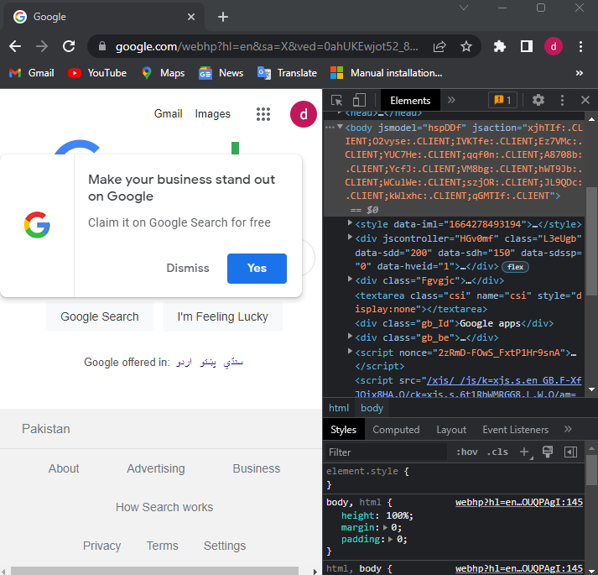
Using the browser console
If you hit F12 on a Windows computer while you are in the web browser, or you right-click and select Inspect on macOS systems, you will see a screen appear, similar to the one in the following screenshot.
There are multiple tabs in this panel for inspecting the page.
Notes:
OOP = Object Oriented Programming
FP = Functional Programming

Slide 37
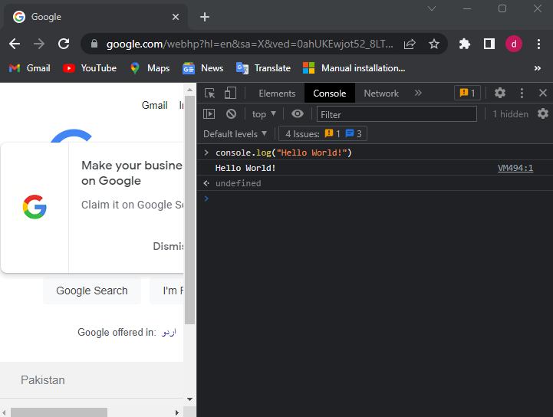
Using the browser console
The console is used by developers to log what is going on and do any debugging.
Click on the console tab and type console.log("Hello world!"); And press Enter key.
Notes:
OOP = Object Oriented Programming
FP = Functional Programming

Slide 38
Adding JavaScript to a web page

Slide 39
Adding JavaScript to a web page
There are two ways to link JavaScript to a web page.
The first way is to type the JavaScript directly in the HTML between two <script> tags. <html> <script type="text/javascript"> alert("Hello World!"); </script> </html>
The second way is to create a file with extension of .js and link it to our web page. <html> <script type="text/javascript" src="hello_world.js"></script> </html>
Notes:
OOP = Object Oriented Programming
FP = Functional Programming

Slide 40
Writing JavaScript code

Slide 41
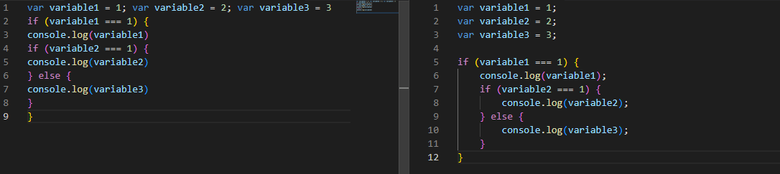
Writing JavaScript code
Formatting code:
Code needs to be formatted well. If you have a long file with many lines of code and you didn't stick to a few basic formatting rules, it is going to be hard to understand what you've written.
The two most important rules for formatting the code are indentations and semicolons.
Notes:
OOP = Object Oriented Programming
FP = Functional Programming

Slide 42
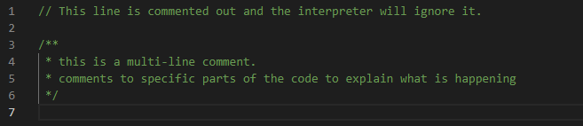
Writing JavaScript code
Code comments:
With comments, you can tell the interpreter to ignore some lines of the file. They won't get executed if they are comments.
Adding comments to specific parts of the code to explain what is happening or why a certain choice has been made.
Notes:
OOP = Object Oriented Programming
FP = Functional Programming

Slide 43
JavaScript Essentials
Chapter 2

Slide 44
Variables

Slide 45
Variables
Variable means anything that can vary.
A JavaScript variable is simply a name of storage location.
A variable must have a unique name.
Notes:
OOP = Object Oriented Programming
FP = Functional Programming

Slide 46
Variables
Variables are values in your code that can represent different values each time the code runs.
The first time you create a variable, you declare it. And you need a special word for that: let , var , or const . Example: let firstname = "Ali";
The commonly used naming conventions used for variables are camel-case. Example: let firstName = "Ali";
Notes:
OOP = Object Oriented Programming
FP = Functional Programming

Slide 47
Variables Scope
LOCAL
GLOBAL
Notes:
OOP = Object Oriented Programming
FP = Functional Programming

Slide 48
Variables Names
﻿A variable name can't contain any spaces
﻿﻿﻿A variable name can contain only letters, numbers, dollar signs, and underscores.
The first character must be a letter, or an underscore (-), or a dollar sign ($).
﻿﻿﻿Subsequent characters may be letters, digits, underscores, or dollar signs.
Numbers are not allowed as the first character of variable.
Notes:
OOP = Object Oriented Programming
FP = Functional Programming

Slide 49
Comments
Single line Javascript comments start with two forward slashes (//).
All text after the two forward slashes until the end of a line makes up a comment
Even when there are forward slashes in the commented text.
Multi-line Comments
Multi-line comments start with /* and end with */.
Any text between /* and */ will be ignored by JavaScript.
Notes:
OOP = Object Oriented Programming
FP = Functional Programming

Slide 50
Statements
A computer program is a list of "instructions" to be "executed" by a computer.
In a programming language, these programming instructions are called statements.
A JavaScript program is a list of programming statements.
JavaScript applications consist of statements with an appropriate syntax. A single statement may span multiple lines. Multiple statements may occur on a single line if each statement is separated by a semicolon.
Notes:
OOP = Object Oriented Programming
FP = Functional Programming

Slide 51
Let, Var, Const
Hoisting of var
Hoisting is a JavaScript mechanism where variables and function declarations are moved to the top of their scope before code execution.
Hoisting of let
Just like var, let declarations are hoisted to the top. Unlike var which is initialized as undefined, the let keyword is not initialized. So if you try to use a let variable before declaration, you'll get a Reference Error.
Notes:
OOP = Object Oriented Programming
FP = Functional Programming

Slide 52
Primitive data types

Slide 53
Primitive data types
String
A string is used to store a text value. Example: let firstName = "Ali";
Number
A number is used to store a numeric value. Example: let score = 25;
Boolean
A boolean is used to store a value that is either true or false. Example: let isMarried = false;
Undefined
An undefined type is either when it has not been defined or it has not been assigned a value. Example: let unassigned;
Null
null is a special value for saying that a variable is empty or has an unknown value. Example: let empty = null;
Notes:
OOP = Object Oriented Programming
FP = Functional Programming

Slide 54
Template Literals
A new and fast way to deal with strings is Template Literals or Template String.
How we were dealing with strings before ?
var myName = "daniyal" ;
var hello = "Hello "+ myName ;
console.log(hello); //Hello daniyal
Notes:
OOP = Object Oriented Programming
FP = Functional Programming

Slide 55
Template Literals
What is Template literals ?
As we mentioned before , it’s a way to deal with strings and specially dynamic strings ; so you don’t need to think more about what’s the next quote to use single or double.
How to use Template literals
It uses a `backticks` to write string within it.
Notes:
OOP = Object Oriented Programming
FP = Functional Programming

Slide 56
Analyzing and modifying data types

Slide 57
Analyzing and modifying data types
You can check the type of a variable by entering typeof. Example: let testVariable = 1; console.log(typeof testVariable);
The variables in JavaScript can change types. Sometimes JavaScript does this automatically. Example: let v1 = 2; let v2 = “2”; console.log(v1 * v2); // 4 ← Type Number console.log(v1 + v2); // “22” ← Type String
Notes:
OOP = Object Oriented Programming
FP = Functional Programming

Slide 58
Analyzing and modifying data types
There are three conversion methods:
String() ← converts to string type
Number() ← converts to number type
Boolean() ← converts to boolean type
Notes:
OOP = Object Oriented Programming
FP = Functional Programming

Slide 59
Operators

Slide 60
Operators
Arithmetic operators:
Addition Example:
let n1 = 1; let n2 = 2; console.log(n1 + n2); // 3
let str1 = “1”; let str2 = “2”; console.log(str1 + str2); // “12”
Notes:
OOP = Object Oriented Programming
FP = Functional Programming

Slide 61
Operators
Arithmetic operators:
Subtraction Example:
let n1 = 5; let n2 = 2; console.log(n1 - n2); // 3
Multiplication Example:
let n1 = 5; let n2 = 2; console.log(n1 * n2); // 10
Notes:
OOP = Object Oriented Programming
FP = Functional Programming

Slide 62
Operators
Arithmetic operators:
Division Example:
let n1 = 4; let n2 = 2; console.log(n1 / n2); // 2
Exponentiation Example:
let n1 = 2; let n2 = 2; console.log(n1 ** n2); // 4
Notes:
OOP = Object Oriented Programming
FP = Functional Programming

Slide 63
Operators
Arithmetic operators:
Modulus Example:
let n1 = 10; let n2 = 3; console.log(n1 % n2); // 1
Notes:
OOP = Object Oriented Programming
FP = Functional Programming

Slide 64
Operators
Assignment operators:
Assignment operator are used to assigning values to variables. Example:
let n = 5; console.log(n); // 5 n += 5; console.log(n); // 10 n -= 5; console.log(n); // 5
Notes:
OOP = Object Oriented Programming
FP = Functional Programming

Slide 65
Operators
Comparison operators:
Comparison operator are used to compare values of variables. Example:
let n = 5; console.log(n == 5); // true console.log(n === 5); // true console.log(n != 5); // false console.log(n > 8); // false console.log(n < 8); // true console.log(n >= 8); // false console.log(n <= 8); // true
Notes:
OOP = Object Oriented Programming
FP = Functional Programming

Slide 66
Operators
Logical operators:
Logical operator are used to combine multiple conditions in one. Example:
let n = 5; console.log(n >= 5 && n < 10); // true console.log(n > 5 && n < 10); // false console.log(n >= 5 || n < 10); // true console.log(n > 5 || n < 10); // true console.log(!(n < 10)); // false console.log(!(n > 10)); // true
Notes:
OOP = Object Oriented Programming
FP = Functional Programming

Slide 67
Thank You

